Slide 1
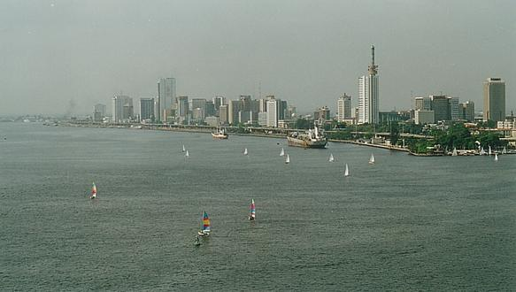
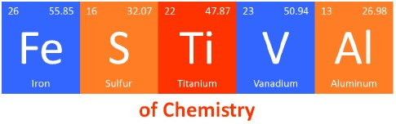
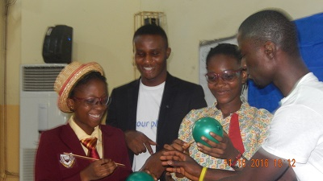

Lagos, Nigeria
November 17, 2016

Slide 2
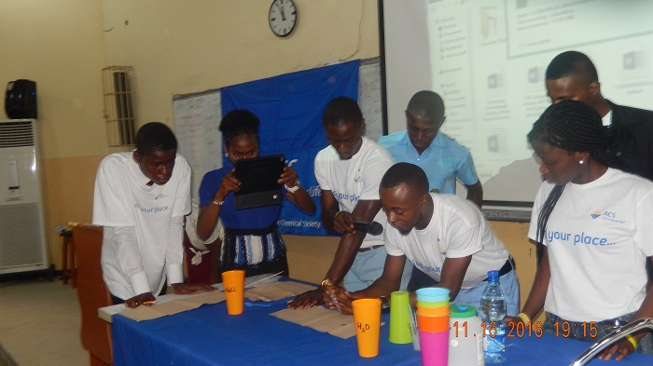
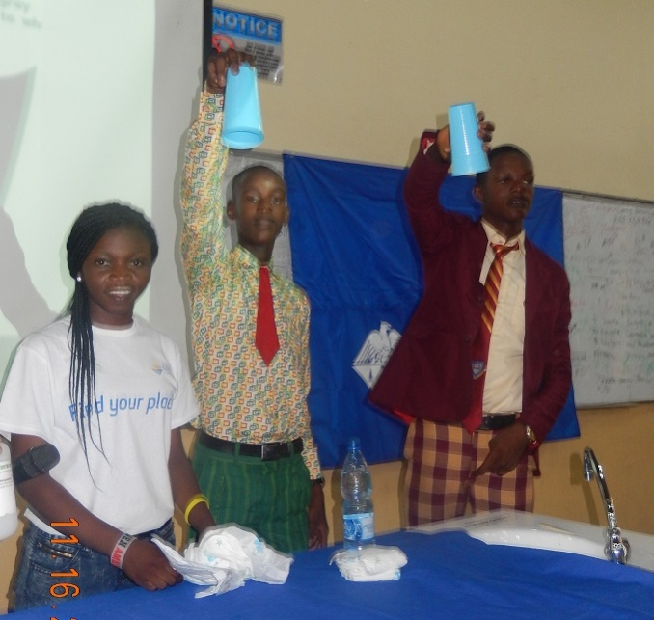
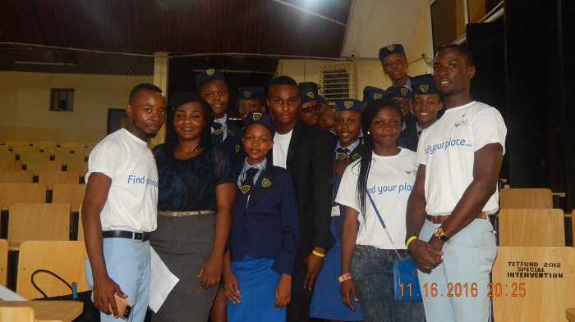
Photo Gallery
Hands-on demonstrations by volunteers and students who participated
Some volunteers & high school student participants
Venue: Faculty of Science Auditorium, Department of Chemistry, University of Lagos, Nigeria
Date: November 17, 2016
Participants: 500 (estimated) with 19 Volunteers
Organizers: Lagos Chapter of Chemical Society of Nigeria; ACS Nigeria Chapter; Department of Chemistry at University of Lagos; University of Uyo Student Chapter of ACS
Guest of Honor: Dr. (Mrs.) Oluranti Adebule, Deputy Governor of Lagos State, Nigeria

Slide 3
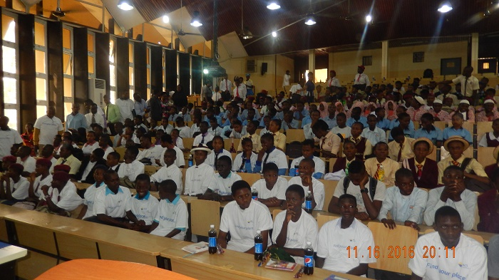
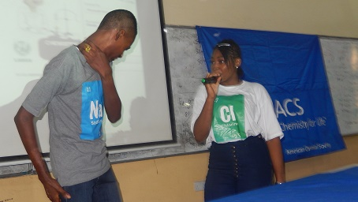
Photo Gallery
“If Elements were Humans”-Chemistry Drama Demonstration by Students
Excited students who participated

Slide 4
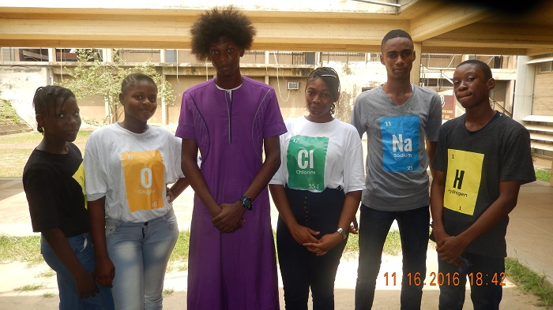
Chemistry Festival @Lagos, Nigeria
List of Volunteers (19):
Link to access Radio and Television Broadcasts:
https://www.dropbox.com/sh/fzavy82s8hjr5xh/AAB4IojhPGY-G14ODhTUzSEIa?dl=0
Contact website: http://www.acsnigeriachapter.org/
“If Elements Were Humans” Drama Crew

